Slide 1
Introduction To WCC
Unit 1 : WIRELESS
COMMUNICATIONS
Andreas F. Molisch
1.2,1.3 and 1.4

Slide 2
Wireless everywhere…
Remote control
Cordless telephone
Headsets
Garage openers
Badges
Cell phones/modems
Radio!
Pagers
Satellite TV
Wireless LAN cards
Cordless headsets, mouse, keyboards, etc.
PDAs.

Slide 3
What is wireless communication?
In layman language it is communication in which information is transferred between two or more points without any wire.

Slide 4
Advantages and disadvantages of wireless communication
Advantages:
Working professionals can work and access Internet anywhere and anytime without carrying cables or wires wherever they go. This also helps to complete the work anywhere on time and improves the productivity.
A wireless communication network is a solution in areas where cables are impossible to install (e.g. hazardous areas, long distances etc.)
Disadvantages:
Has security vulnerabilities
High costs for setting the infrastructure
Unlike wired communication, wireless communication is influenced by physical obstructions, climatic conditions, interference from other wireless devices

Slide 5
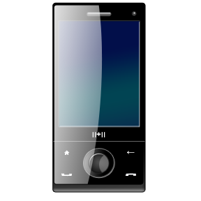
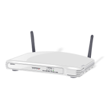
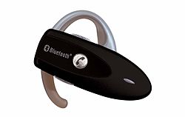
CURRENT WIRELESS SYSTEMS
CELLULAR SYSTEM
WIRELESS LANs
SATELLITE SYSTEM
PAGING SYSTEM
BLUETOOTH

Slide 6
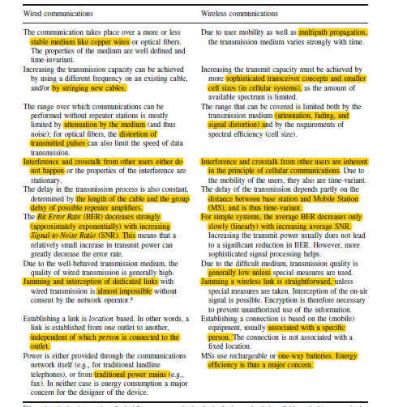

Slide 7
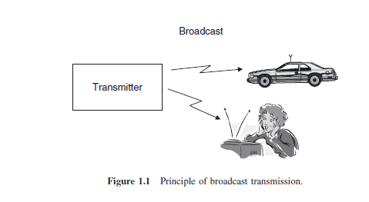
Broadcast

Slide 8
The information is only sent in one direction. It is only the broadcast station that sends information to the radio or TV receivers; the listeners (or viewers) do not transmit any information back to the broadcast station.
The transmitted information is the same for all users.
The information is transmitted continuously.
In many cases, multiple transmitters send the same information.

Slide 9
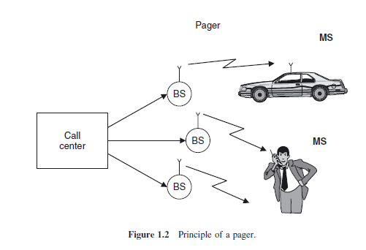
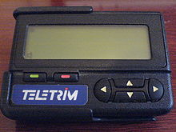
Paging

Slide 10
The user can only receive information, but cannot transmit. Consequently, a “call” (message) can only be initiated by the call center, not by the user.
The information is intended for, and received by, only a single user.
The amount of transmitted information is very small. Originally, the received information consisted of a single bit of information, which indicated to the user that “somebody has sent you a message.”
The user then had to make a phone call (usually from a payphone) to the call center, where a human operator repeated the content of the waiting message.
Later, paging systems became more sophisticated, allowing the transmission of short messages (e.g., a different phone number that should be called, or the nature of an emergency).

Slide 11
Due to small amount of information transmission and communication is unidirectional ,the bandwidth requirement is small and service used to be run with smaller carrier frequency of 150 MHz.

Slide 12
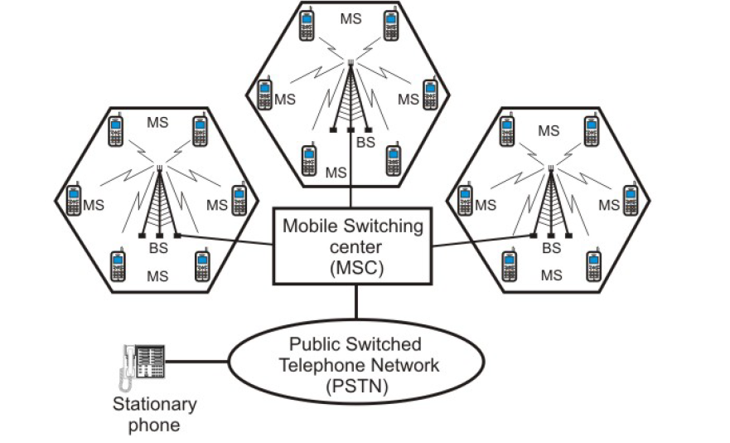
Components of cellular network

Slide 13
The information flow is bidirectional. A user can transmit and receive information at the same time.
A cellular system comprises the following basic components:
Mobile Stations (MS): Mobile handsets (handheld or installed in vehicles), which is used by an user to communicate with another user.
Cell: Each cellular service area is divided into small regions called cell (5 to 20 Km)
Base Stations (BS): Each cell contains an antenna (transreciever), which is controlled by a small office.

Slide 14
Public Switched Telephone Network (PSTN): Connects several thousands of miles of transmission infrastructure, including fixed land lines, microwave, and satellite links.
Mobile Switching Center (MSC): Each base station is controlled by a switching office, called mobile switching center . The MSC is mostly associated with communications switching functions, such as call set-up, release, and routing. It Switches voice traffic from the wireless network to the PSTN if the call is a mobile-to-landline call, or it switches to another MSC within the wireless network if the call is a mobile-to-mobile call.

Slide 15
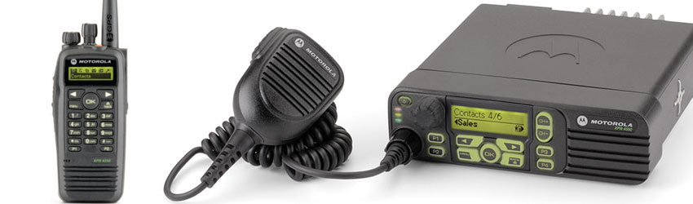
Trunking Radio

Slide 16
Trunking radio systems are an important variant of cellular phones, where there is no connection between the wireless system and the PSTN; therefore, it allows the communications of closed user groups.
Obvious applications include police departments, fire departments, taxis, and similar
services.

Slide 17
The closed user group allows implementation of several technical innovations that are not possible (or more difficult) in normal cellular systems:
Group calls
Call priorities
Relay networks
Notes:
Group calls:Group calls: a communication can be sent to several users simultaneously, or several users can
set up a conference call between multiple users of the system.
Call priorities: a normal cellular system operates on a “first-come, first-serve” basis. Once a
call is established, it cannot be interrupted.6 This is reasonable for cellphone systems, where
the network operator cannot ascertain the importance or urgency of a call. However, for the
trunk radio system of, e.g., a fire department, this is not an acceptable procedure. Notifications
of emergencies have to go through to the affected parties, even if that means interrupting an
existing, lower priority call. A trunking radio system thus has to enable the prioritization of calls
and has to allow dropping a low-priority call in favor of a high-priority one.
Relay networks: the range of the network can be extended by using each Mobile Station (MS)
as a relay station for other MSs. Thus, an MS that is out of the coverage region of the BS might
send its information to another MS that is within the coverage region, and that MS will forward
the message to the BS; the system can even use multiple relays to finally reach the BS. Such
an approach increases the effective coverage area and the reliability of the network. However, it
can only be used in a trunking radio system and not in a cellular system – normal cellular users
would not want to have to spend “their” battery power on relaying messages for other users.

Slide 18
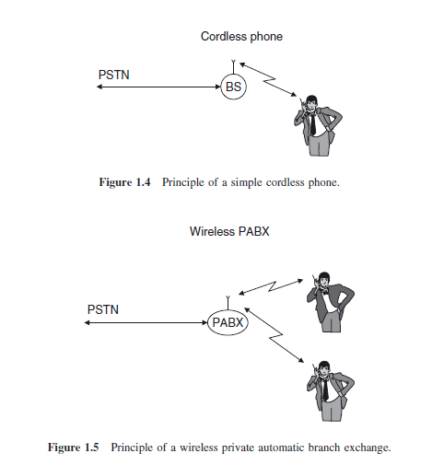
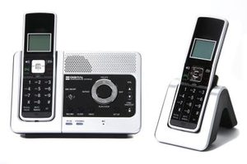
Cordless Telephony
Private automatic branch exchange

Slide 19
Cordless telephony describes a wireless link between a handset and a BS that is directly connected to the public telephone system.
The main difference from a cellphone is that the cordless telephone is associated with, and can communicate with, only a single BS . There is thus
no mobile switching center; rather, the BS is directly connected to the PSTN.

Slide 20
The BS does not need to have any network functionality.
When a call is coming in from the PSTN, there is no need to find out the location of the MS. Similarly, there is no need to provide for handover between different BSs.
There is no central system. A user typically has one BS for his/her apartment or business under control, but no influence on any other BSs. For that reason, there is no need for (and no possibility for) frequency planning.

Slide 21
Cordless systems have also evolved into wireless Private Automatic Branch eXchanges (PABXs)
In its most simple form, a PABX has a single BS that can serve several handsets
simultaneously – either connecting them to the PSTN or establishing a connection
between them (for calls within the same company or house).
In its more advanced form, the PABX contains several BSs that are connected to a central control station.
Such a system has essentially the same functionality as a cellular system; it is only the size of the coverage area that distinguishes such a full functionality wireless PABX from a cellular network.

Slide 22
The Difference Between a Cordless & Cellular Phone
CORDLESS PHONES | CELL PHONES
Cordless phones consist of a base station and the cordless phone itself. A cordless phone will not work if it is outside of the range of the base station. | If the cell phone moves outside of the tower's range, the cell phone network automatically transfers the call to another tower so that the user can continue his call as long as he is within range of at least one tower.
Cordless phones do not need to be registered with the phone company. | Before using a cell phone, you need to activate the device with the cellular service provider either by installing an activated SIM card or by contacting the service providers.

Slide 23
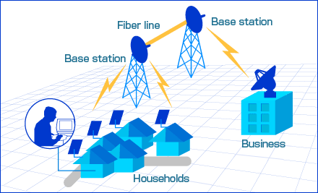
Fixed Wireless Access (FWA)
It is a type of wireless broadband data communication, which is performed between two fixed locations - connected through fixed wireless access devices and equipment..
Traditionally, enterprises used leased lines or cables to connect two different locations. FWA is cheaper alternative, specifically in densely populated areas.
Typically, FWA employs radio links as the communication and connecting medium between both locations. Usually, the fixed wireless broadcasting equipment is hoisted at building roofs on both the locations to ensure an obstruction free data transmission.

Slide 24
Wireless local area networks
The functionality of Wireless Local Area Networks (WLANs) is very similar to that of cordless phones – connecting a single mobile user device to a public landline system. The “mobile user device” in this case is usually a laptop computer and the public landline system is the Internet.

Slide 25
Personal area networks
Devices following the Bluetooth standard allow to connect a hands-free headset to a phone without requiring a cable;

Slide 26
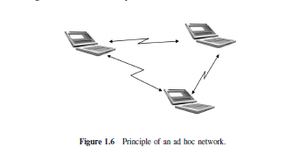
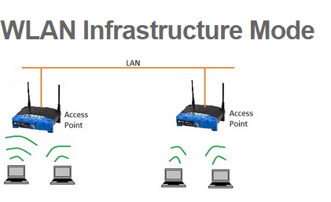
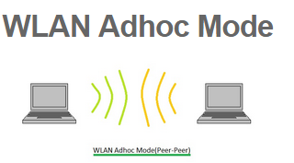
Ad-Hoc Networks
EX: Sensors

Slide 27
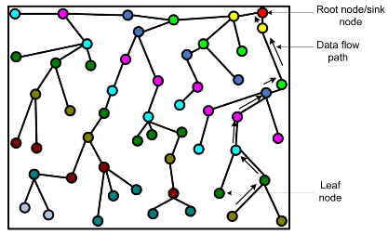
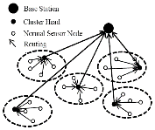

Slide 28
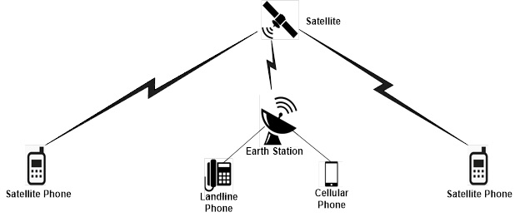
Satellite Communication

Slide 29
The distance between base station and mobile station is much larger.
The cell size is larger.
Expensive.
Used by emergency users like reporters, war areas, ship based communications.

Slide 30
Requirements for the Services
Data Rate
Range and no. of users
Mobility
Energy Consumption
Direction of transmission
Service Quality

Slide 31
Data Rates
Sensors : up to 1 kbits/s ; central nodes upto 10Mbits
Speech: 5 to 64kbits/s; cordless phones : 32 kbits/s and cellphones : 10kbits/s
Elementary data services require between 10 and 100 kbit/s.
Communications between computer peripherals and similar devices: 1Mbits/s
High-speed data services: WLANs and 3G cellular systems 0.5 to 100Mbits/s
Personal Area Networks (PANs): over 100Mbits/s

Slide 32
Range and Number of Users
Body Area Networks : 1m
Personal Area networks : 10m
Wireless Area Network : 100m; no.of users :10 ; cordless phones :300m
Cellular Systems: 500m; no.of users :5 -50
Fixed wireless access services: between 100m and several tens of kilometers
Satellite Systems

Slide 33
Mobility
Fixed Devices : telephones
Nomadic Devices: laptop
Low Mobility: cordless
High Mobility:cellphones
Extremely High Mobility: cellphones in a moving car

Slide 34
Energy Consumption
Rechargeable Batteries: mobiles
One Way Batteries: sensors
Power Mains: antennas

Slide 35
Use Of Spectrum
Spectrum dedicated to service and operator
Spectrum allowing multiple operators
Spectrum dedicated to a service
Free Spectrum :The ISM( industrial, scientific, and medical radio ) band at 2.45 GHz is the best known example – it is allowed to operate microwave ovens,WiFi LANs, and Bluetooth wireless links, among others,
Ultra Wide Bandwidth systems
Adaptive spectral usage

Slide 36
Direction Of Transmission
Simplex: broadcast systems :TV
Semi-Duplex: walkie talkie
Full Duplex: cell phones
Asymmetric Duplex: digital subscriber line (DSL) technologies

Slide 37
Service Quality
Speech quality: Mean Opinion Score
Data Services : file transfer service:bits/s
Delay :
Voice : 100ms
Video : Streaming allowed
Critical Services
Service Quality
Cell phones : the complement of “fraction of blocked calls plus 10 times fraction of dropped calls.”
For emergency services and military applications: the complement of “fraction of blocked calls plus fraction of dropped calls.”

Slide 38
Economic and Social Aspects Economic Requirements for Building Wireless Communications Systems
Use less expensive digital circuitry than costly analog components.
Integrate all components into 1 chip rather than using 2 chips (one for analog RF circuitry and one for digital(baseband) processing).
Reduce human labour
Same chips should be used in as many systems as possible.
Reduce price difference between wired and wireless systems.
Cost of building infrastructure should be less than wired systems

Slide 39
The Market for Wireless Communications
Factor influencing the market:
Price of the offered services
Price of MS
Attractiveness of the offered services
General economic situation
Existing telecom infrastructure
Predisposition of the population

